Slide 1

Online Food Ordering System

Slide 2
EVENT TABLE
Event | Trigger | Source | Use case | Response | Destination
Customer creates account | Customer details | Customer | Create new account | Account ID | Customer
Customer creates new order | Customer account credentials | Customer | Create new order | Order summary | Customer
Customer updates order | - Order ID - Order state | Customer | Update order | New order summary | Customer
Customer cancels order | - Order state - Order ID | Customer | Cancel order | Canceling confirmation | - Customer - Delivery worker - Chief
Customer searches for a meal | Meal name | Customer | Look up for a meal | Meal details | Customer
Customer gives feedback for a meal | Customer account credentials | Customer | Add meal feedback | Feedback report | - Customer - Administrator

Slide 3
EVENT TABLE
Event | Trigger | Source | Use case | Response | Destination
Administrator adds a new meal | - Meal name - Meal picture - Meal description | Administrator | Add new meal | Meal ID | -Administrator - Customer
Administrator updates meal | Meal ID | Administrator | Update meal description | Meal details | - Administrator - Customer
Administrator deletes a meal from the system | Meal ID | Administrator | Delete meal | Delete Confirmation | Administrator
Administrator adds new offer for a meal | Offer details | Administrator | Add new offer | Start and end time of offer | Customer
Time to create monthly summary reports for sales | End of month |  | Create monthly Summary reports | Sales summary reports | Management
Customer checks order state | - Order ID / Details | Customer | Check order state | Order state | Customer

Slide 4
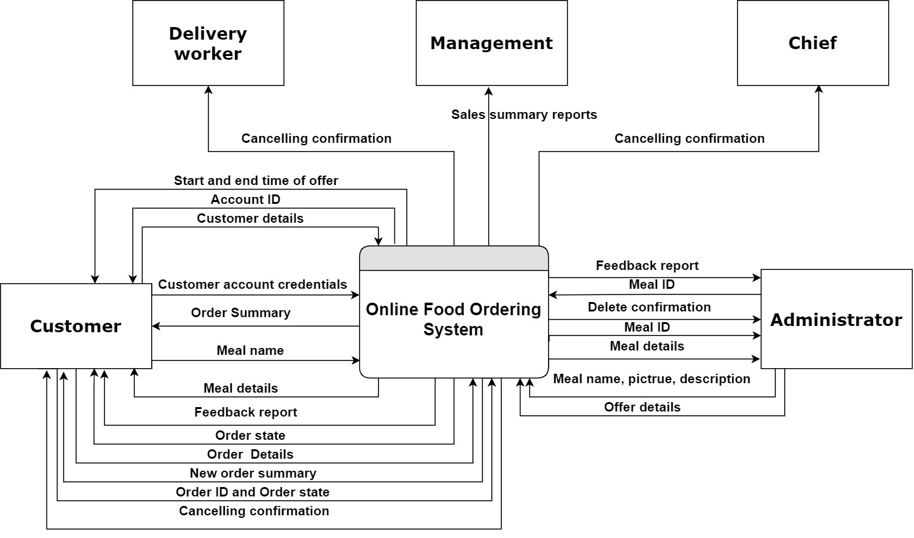
Context diagram for the System

Slide 5
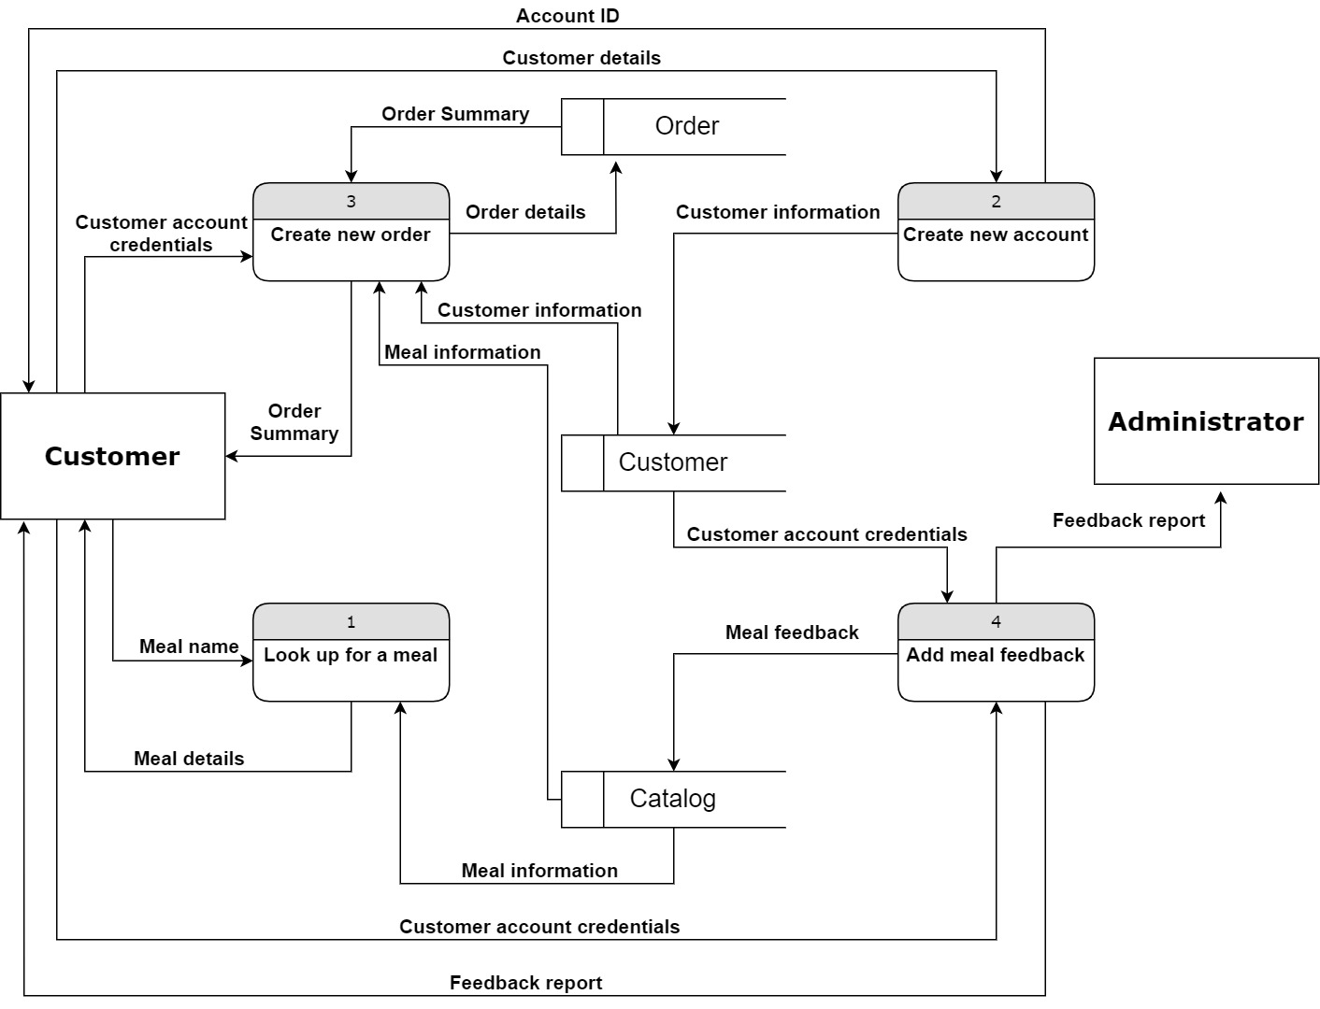
DFD Overview for order entry subsystem

Slide 6
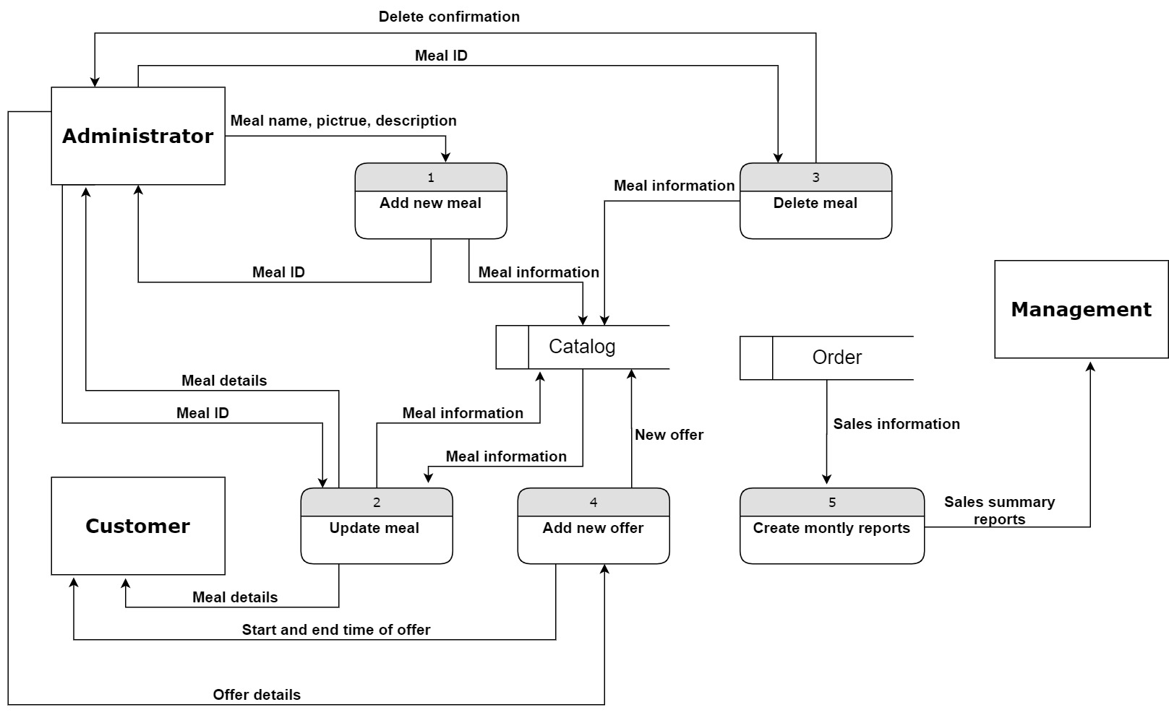
DFD Overview for Administration Subsystem

Slide 7
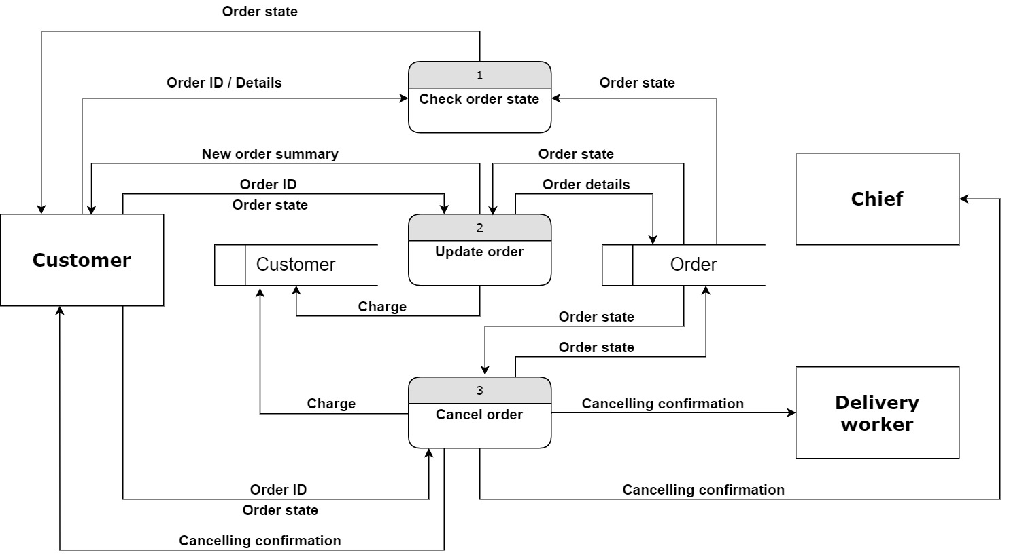
DFD Overview for order state Subsystem

Slide 8
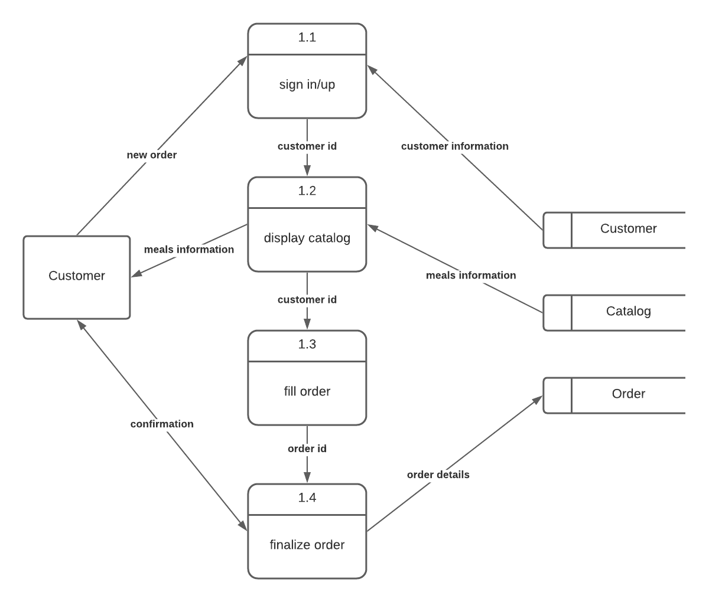
DFD Details of create new order
Order details
Order details

Slide 9
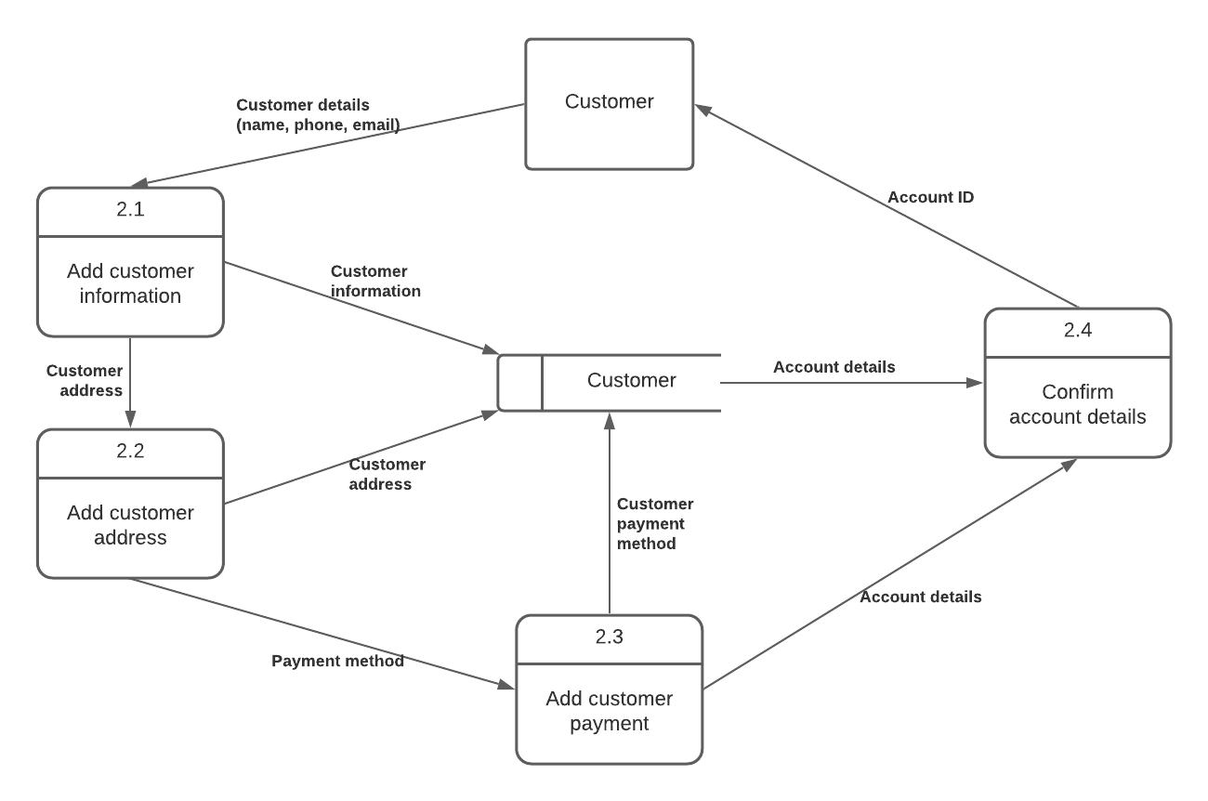
DFD Details of create new account

Slide 10
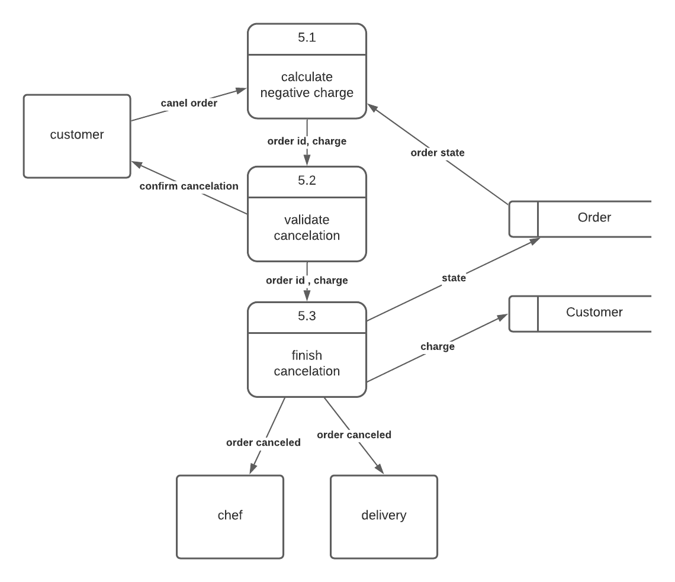
DFD Details of Cancel order

Slide 11
Structured English for cancel order
Structure of 5.1 calculate negative charge process
Get order state , order total price and order delivery beginning from Order database
Calculate the delivery time in seconds
If order state is cooking or packing, then
charge = 0
Else
charge = (0.3 * order total price + 0.01 * delivery time in seconds) pound
Endif
Structure of 5.2 validate cancelation process
Alert customer with the negative charge
If customer rejected to cancel, then
Finish the process
Endif
Structure of 5.3 finish cancelation
Change order state to canceled
Alert the chef and the delivery that the order has been canceled
If negative charge > 0 then
Add negative charge to the customer database
Notes:
<number>

Slide 12
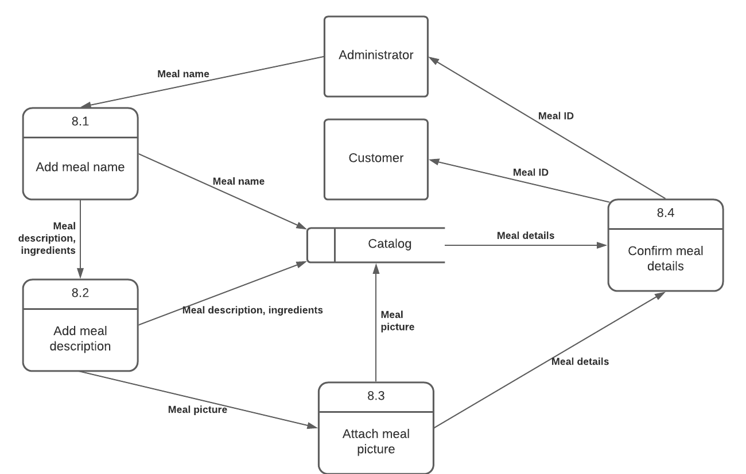
DFD Details of add new meal

Slide 13
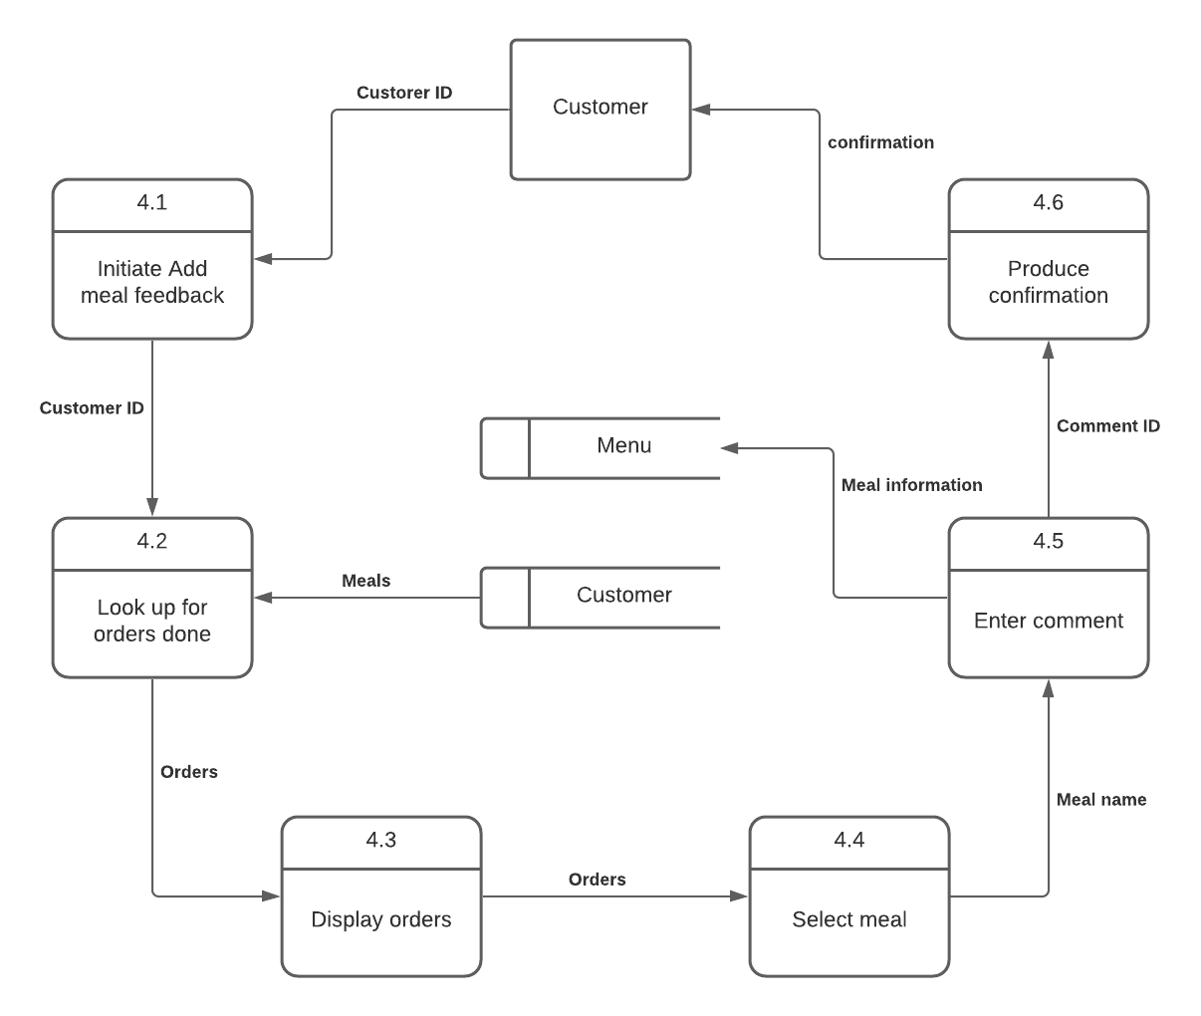
DFD Details of Add meal feedback

Slide 14
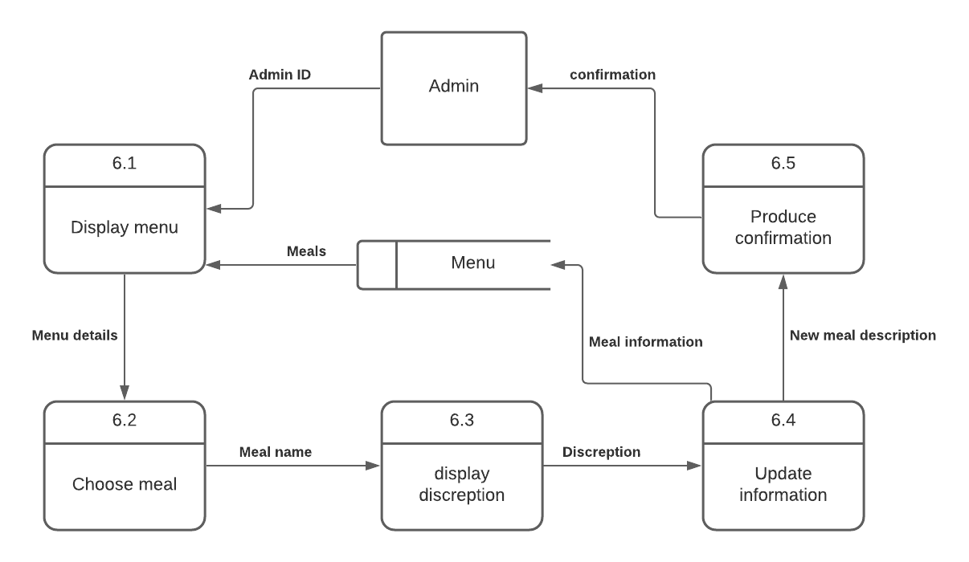
DFD Details of update meal

Slide 15
Structured English for update meal
Display menu
Choose a meal to update its description
Update the information of the chosen meal
Produce confirmation with changed data for admin to confirm valid data.
Apply Changes to store in data base.

Slide 16
Structured English for add meal feedback
Look for Meals ordered by the customer and was delivered to him.
Display the Meals to customer so the customer can choose from them.
Accept the customer feedback related to the chosen meal
Produce confirmation with the feedback done by the customer.
Add feedback to meal information in data base.
return feedback to the admin to review

Slide 17
Structed English for create new account
Create an empty Customer record in the database
Ask Customer for Customer Information (name, phone number, email)
Ask Customer for Customer Address
Ask Customer for Customer Payment method
Update empty Customer record with Customer details

Slide 18
Structed English for Add new meal
Create an empty Meal record in the database
Ask Administrator for Meal name
Ask Administrator for Meal description and ingredients
Ask Administrator for Meal picture
Update empty Meal record with Meal details

Slide 19
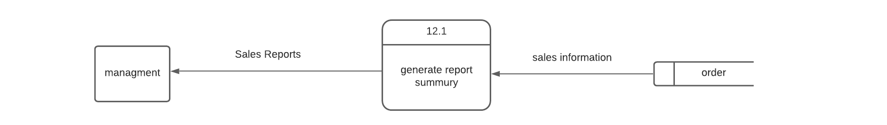
DFD Details of Create monthly Summary reports

Slide 20
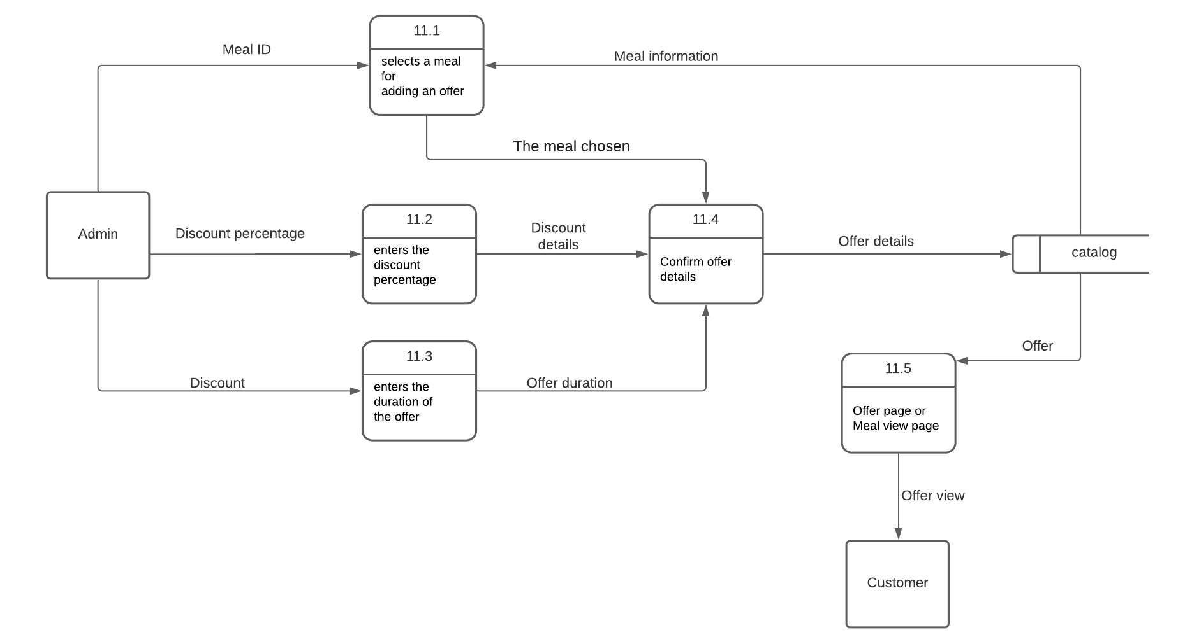
DFD Details of Add new offer

